Slide 1
DataPlay: Interactive Tweaking and Example-driven Correction of Graphical Database Queries
Azza Abouzied, Joseph Hellerstein, Avi Silberschatz, UIST 2012
CS 598 Presentation
Doris Jung-Lin Lee

Slide 2
Querying a Database is hard
⁇
How: Language barrier
What: Conceptual barrier
Which: Schema barrier
Where: Data barrier
Why: Interpretation barrier
Kersten et al. (VLDB’11), Jagadish et al. (SIGMOD’07)
Notes:
Database usability is a important problem that has been tackled by database and HCI researchers. The paper looks at a specific instance of the database usability, specifically how to make it easier for people to query a database. First, the defect way of querying a database through SQL queries is hard, often because of the language barrier: novices don’t know how to write SQL queries. But the problem is more than that. There’s also the conceptual barrier or operational barrier, for example, its is notorious that while selection, projections are easy to understand joins, especially across multiple tables and relations, are hard for people to understand. We have seen in the previous 2 papers that the gesture based approach is one attempt at addressing this problem, as well as other visual query interfaces that we’ve read about. Then there’s the schema and data barrier. Writing complex SQL queries is often hard because it requires that the users have a clear mental model of the database schema (which columns depend on what ,etc). Finally related to the schema, is across multiple tables, where does the data of interest lie in, should I perform a join with what table on what relations? (what foreign key relations do I have to watch out for?) Finally, even if we were successfully able to query the database, why is this result the way it is? How do we interpret the result that is returned from the database?

Slide 3
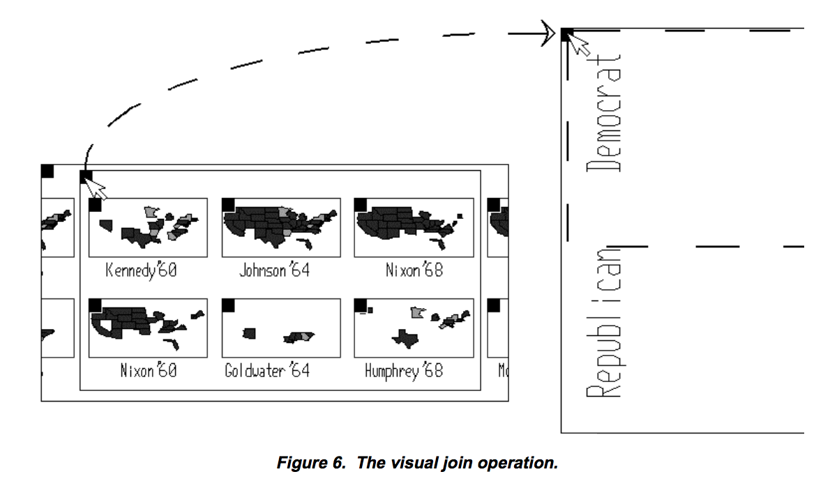
Problem
Existing query specifications makes it hard to specify quantified queries.
VIQING: Visual Interactive QueryING, Olsten et al. (1998)
Faceted Search
Notes:
The paper address the important problem of how to make it easier to query a database in the perspective of how to make it easier for users to submit queries to a database. They cited two lines of work in visual interfaces and faceted search for query specification that tried to address this. Visual queries are when you do some GUI operation (e.g. drag and drop, mouse clicks) on visualizations to perform a database query (such as join and reordering in this paper). Faceted search are some entity/filter concept that could be used for pivoting query specification and search. But all of these approaches doesn’t allow you to specify complex quantified queries.

Slide 4
Quantified queries
Quantified queries: evaluates constraints over sets of tuples to determine whether a set satisfies the queries.
Universal quantifiers (∀): “All roses in the bouquet should be red.”
Existential quantifiers (∃): “There exist at least one white rose in the bouquet”
Notes:
The paper focus on a particular class of queries called quantified queries.

Slide 5
Challenge
Quantified queries often clarified through trial-and-error.
Trial and error is hard:
1) SQL has no “syntax locality” 2) SQL does not present “non-answers”
∀ students who got all As
∃ at least one A student
SELECT * FROM student s, takes t WHERE t.student_id = s.id AND s.id NOT IN
(SELECT student_id FROM takes WHERE grade != ’A’);
SELECT * FROM student s, takes t, WHERE t.grade = ’A’ AND t.student_id = s.id;
⁇
DTW
LAX
Why Not? Chapman and Jagadish (2009)
Notes:
They have an example in the intro showcasing how these types of queries are very common in casual natural language requests. In this examples, they show how people often “correct their queries” (clarify misunderstanding) during these requests. So in theory, the trial-and-error approach should also be used for querying a database.
This is challenging for two reasons: 1) there is no syntax locality, which means when you make a small change to the semantic meaning of the query, you need a lot of changes in the SQL code. This is an example from the paper where they have at least one A student in the first query, if you want to change it into an universal quantifier (i.e. find students who got all As) the SQL looks pretty different.
2) Another thing about SQL is that it doesn’t give you non-answers, i.e. it tells you which tuples is a result of the query, but it doesn’t tell you which ones are not show. you might want to know about this, using an example from a related paper. A business traveler searches for flights on a popular flight booking web site, he cannot understand why there is no direct flight from Detroit to LA listed. But he took that flight last week, so why is it not in the result set? The paper lists that this could be because the query is ill-formatted, user’s mental model does not agree with the what the system expects as an input, or maybe that record doesn’t exist in the database at all. But users are interested in knowing “Why is this result not part of the answer?”.

Slide 6
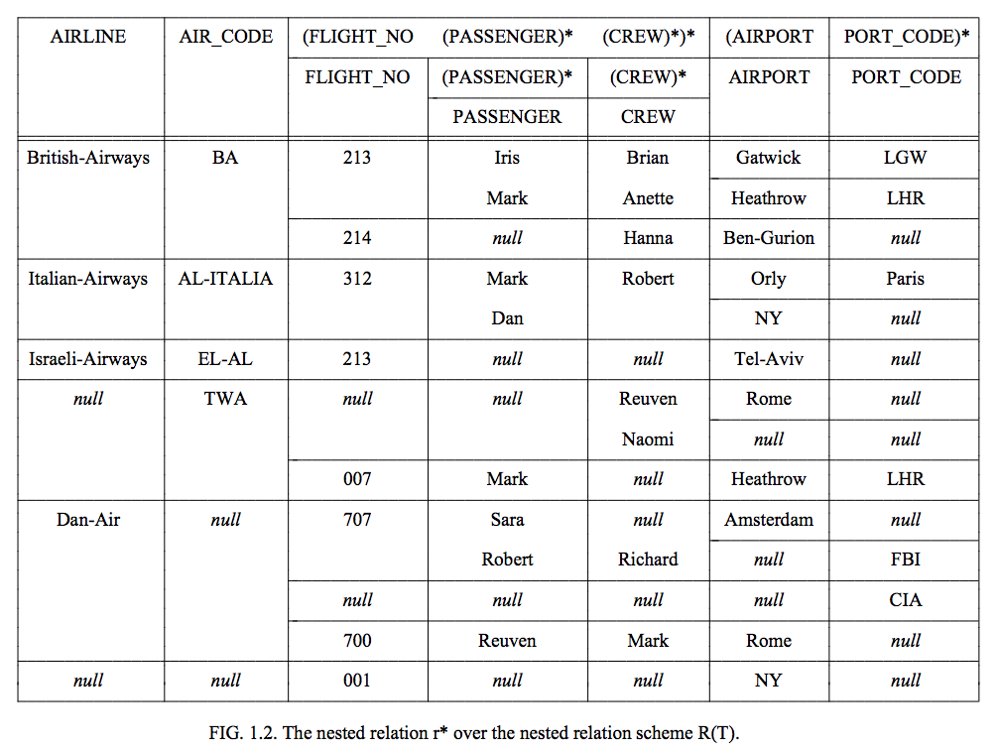
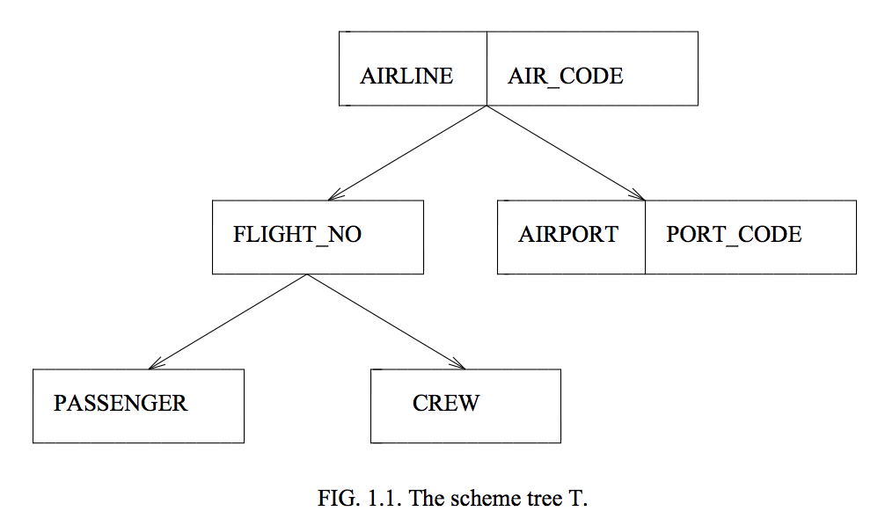
Data Model
nested universal relation=nested data model+ universal relations
Benefits:
no need for joins or group construction
closed world assumption ∴ non answers can be easily computed as (universe - answers)
The nested universal relation data model, Levene and Loizou (1994)
Notes:
They proposed the use of the nested universal relations as their data model. This was a data model developed in the 90s that combines the idea of nested models (data consists of nested relations like in XML, JSON, or what we saw in Dremel) and universal relations (which is the idea that you can have one very large “universal” table containing all data attribute, not normalized into individual tables). Doing this provides logical data independence so that any changes in the database does not affect the user’s view of the database. There are several listed benefits of their design choice. Because we have this “universal” table, the users do that need to do join or group construction subqueries, which makes queries more complex and challenging to compose.

Slide 7
Question
How does the choice of this data model limit the expressive power of DataPlay compared to SQL?
Notes:
So one thing they mention in the paper is that the universal data model limits the expressiveness of DataPlay, how does the choice of this data model limit the expressiveness of queries?
Since the data model is one large denormalize (all join) table, it probably makes modifications to the database harder (because it might be harder to deal with update anomalies)

Slide 8
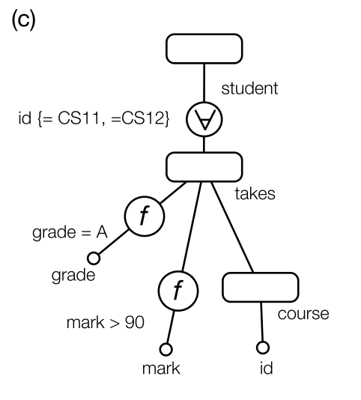
Graphical query language
Data tree is a key-graph with:
edges: primary-foreign key relationships
nodes: relations
Query tree represents a query and are data trees overlaid with constraints.
Pivot
Quantifier
Relation
Notes:
They define their graphical query language based on the nested universal relation model. The paper describe data tree as a tree with nodes as relations and edges as primary foreign key relationships. Query trees are simply data trees overlaid with constraints. Query trees have a Pivot at the root node which is a user-specified assembly of a nested universal table from other tables.
In the query tree representation, it is easy to see how it is easy it is to switch out an existential quantifier with an universal quantifier and graphically modify the query. If the constraint node operates over individual tuples rather than it set, f is the no quantifier symbol (since forall=exist). Coverage is a notion used to ensure all of the constraints for the tuples are satisfied, and is displayed via shading.

Slide 9
Auto-correction
When query complexity increases, debugging becomes hard → autocorrection
correcting misplaced tuples into answer and non-answer categories
System looks at the space of all “tweaks” to the current query tree and recommends query tree
Notes:
In order to address the problem of how to correct for queries when the query becomes very complex. They developed a module for autocorrecting the query. The users can select examples of misplaced tuples, that should or should not appear in the answers. The generation of non-answer is simply the set difference between all the items in the set minus the answer set, due to the closed world assumption of the nested universal model. This user feedback allows the system to generate a space of all “tweaks” to the current query tree and recommends query tree of that satisfies the “want-in, keep-out” examples.

Slide 10
DataPlay Features
Notes:
Now I will highlight the features of the DataPlay System that addresses these challenge and discuss them in more detail. Here is a video that show cases some of the features in Dataplay. In this video, they have a student dataset and the user is trying to find students who did well in philosophy classes.

Slide 11
Evaluation Methodology
randomized, between-group evaluation study with 13 students familiar with DB querying.
Baseline: Direct Manipulation interface
Task: 3 querying tasks of increasing difficulty for 2 different datasets (students, flights)
Starting point: given query tree or query
Notes:
They evaluated DataPlay in a user study with 13 participants who were taking an undergrad database course. They adopted a between-group experimental design, which means that they assigned multiple groups of participants using either DataPlay or their direct manipulation baseline. They gave users specific tasks to accomplish given a query tree or query to begin with, they needed to use the interface to correct their query to do the desired actions. The level of difficulty of a task is quantified by how many tweaks away does the given query take to get to the desired query.

Slide 12
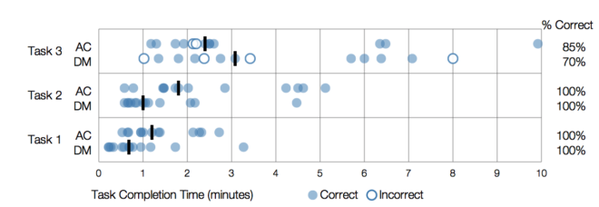
User Study Results
Increasing Difficulty
As query complexity increased, autocorrection tool performs significantly than DM. (For the two easier task, DM was faster.)
Users found autocorrection and display of non-answers to be useful for query debugging.

Slide 13
Question
How can the study/analysis be improved?
Notes:
How can the study/analysis be improved? In other words, What was missing in the evaluation to say that DataPlay is a tool that can help people query databases better than SQL?
What was not tested in the user study?
Tasks were designed for query debugging perspective, but DataPlay is trying to solve a bigger problem of query specification. Can users really use this to come up with free formed queries?

Slide 14
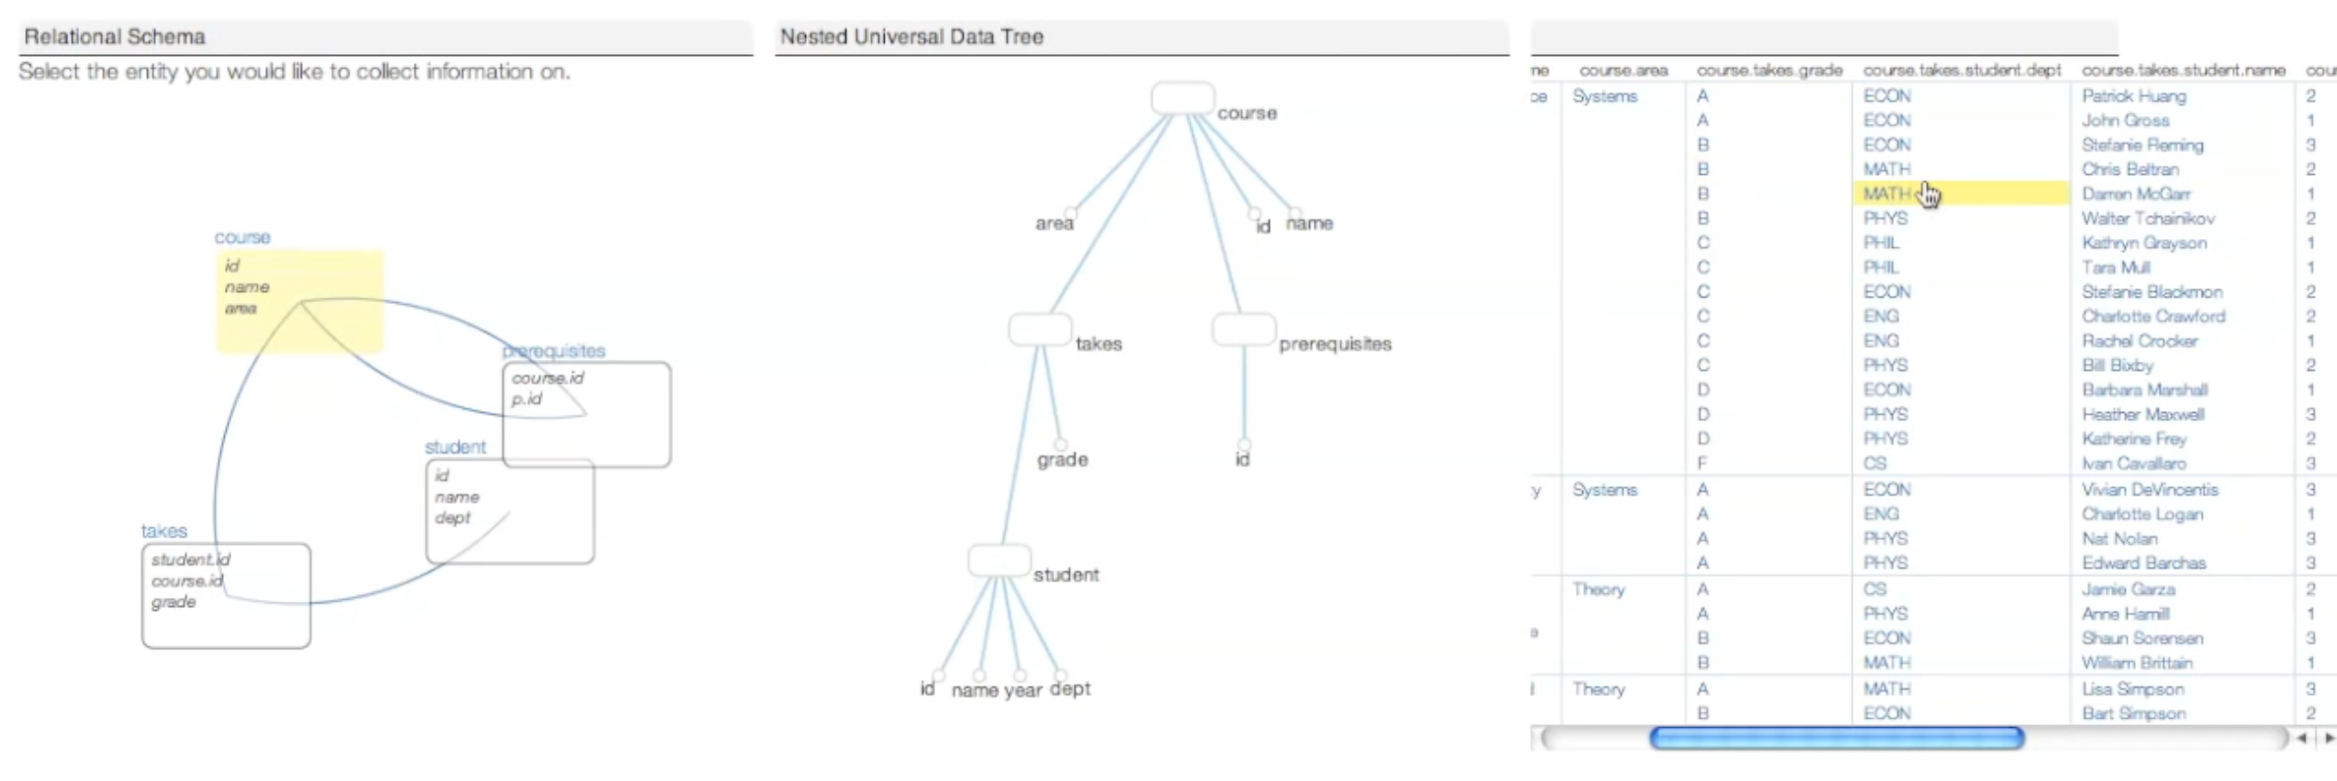
DataPlay:Querying a Database is hard
made easier?
⁇
How: Language barrier
What: Conceptual barrier
Which: Schema barrier
Where: Data barrier
Why: Interpretation barrier
How: Language barrier
What: Conceptual barrier
Which: Schema barrier
Where: Data barrier
Why: Interpretation barrier
No SQL!
Skipped
want-in, keep-out
Notes:
Now to summarize in the beginning of the lecture, we talked about the various issues related to database usability. Now let’s look at how the DataPlay design addresses these.
The language barrier is addressed because the users in DataPlay don’t need to write SQL directly. DataPlay make it easier for people to perform query manipulation by modifying the tree and having toggle-able quantifiers. The conceptual barrier problem is somewhat avoided by the paper because they focussed on quantified queries, so it only involved adding and removing constraints, so users would not be boggled with as much operational options as in a full fledged query language.
Schema and data barrier is addressed by the visualization of the relational data model and nested model that display what the data and records look like. They didn’t focus it on the paper too much, but that is important.
For the interpretation barrier, while their system didn’t exactly explain why or why not, they gave the users a mechanism to chose what result should or should not be in the resultset to improve their query, and aligning the user’s mental model with the system/database’s model.

Slide 15
Summary
DataPlay: easier trial-and-error specification quantified queries.
Nested universal table data model
Syntax locality: Toggling of existential and universal quantifiers. “Tweaks” to queries could be done through graphical manipulation of query tree.
Lack of non-answers: Query correction via examination and selection of answers and non-answers examples.
Notes:
DataPlay is a tool that makes it easier for users to specify quantified queries. Their choice of a nested universal table enabled these to be done more easily than in general SQL queries.
The tool addresses two main challenges in trial-and-error query specification:
Syntax locality: Toggling of existential and universal quantifiers. “Tweaks” to queries could be done through graphical manipulation of query tree.
Lack of non-answers: Correction of the query is done by having the users examine answers and nonanswers, and having them select tuple membership of answer (i.e. want in keep out examples), then DataPlay suggests possible query manipulations that can accommodate these changes.
The idea of Syntactic locality is a valuable takeaway in this paper. In this work they focussed on changing between existential and universal quantifier. This is a useful function, potentially future work can generalize this notion to see how we can find functionally similar queries.

