Slide 1
Making Database Systems Usable
Slides courtesy Jagadish

Slide 2
This paper…
Unusual, provocative paper
  More problems than solutions
  A showcase of the work the group has done
    Naturally, very far from solving the problems
Better to judge the paper for the questions it raises rather than the solutions it provides!

Slide 3
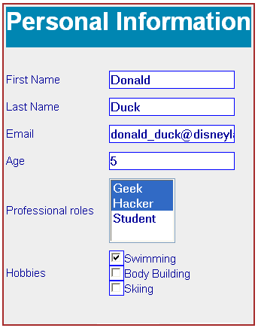
Forms
Simple, but limited.
How do we create a form to query a database?
When would it be appropriate to use?
Discuss!

Slide 4
Forms
Simple, but limited.
How do we create a form to query a database?
When would it be appropriate to use?
Discuss!
  Small number of types of queries
  Small number of predicates
  Small number of joins
  Possibly many values for attributes
  Conceptual schema need not be same as actual schema (e.g., flight database)

Slide 5
Natural Language Interfaces
Pros/Cons?

Slide 6
Natural Language Interfaces
Pros/Cons?
  No need for SQL:
    But not clear how much one can do without knowledge of schema
  Only short queries
  Probably a wider space of queries than forms
  Sometimes can be annoying
    Imagine having to specify flight searches via NL
  The feeling of less control
    Lack of understanding of knobs

Slide 7
Lots of work on Provenance
Fine grained – store origin of every single record
Coarse grained – store at a schema level: this table came from these two tables
Pros/Cons?

Slide 8
Lots of work on Provenance
Fine grained – store origin of every single record
Coarse grained – store at a schema level: this table came from these two tables
Pros/Cons?
Fine-grained: too much data: all-all mappings
Coarse-grained: cannot ask interesting questions

